Slide 1


House Prices: Advanced Regression Techniques
Jules MOTYL / Sébastien PAVOT / Kaveh JALILIAN

Slide 2
Agenda Overview
01
Introduction
Data summary and objectives
02
Data cleaning
Handling missing values & outliers treatments
03
Features engineering
Variables creation & transformation
04
Modelling
Algorithms selections, best models and bagging
05
Results
Kaggle score and models score

Slide 3

Introduction
Data summary and objectives

Slide 4


Competition Objectives
Predict the price of houses
Based on multiple variables
Metrics: Root mean squared Log error
Closest to 0, the best it is
Only the score count
Interpretability and other factors aren’t involved
All languages authorized
We used Python for this competition

Slide 5


Data summary
Train set: 1460 observations
Test set: 1459 observations
Target: SalePrice
Features: 79 predictors

Slide 6
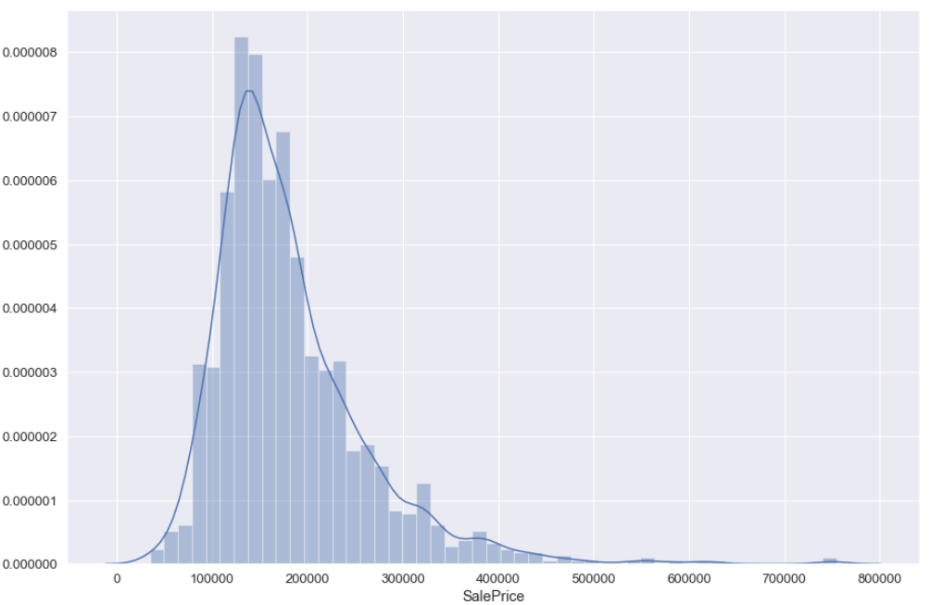
SalePrice distribution
Right skewed

Slide 7
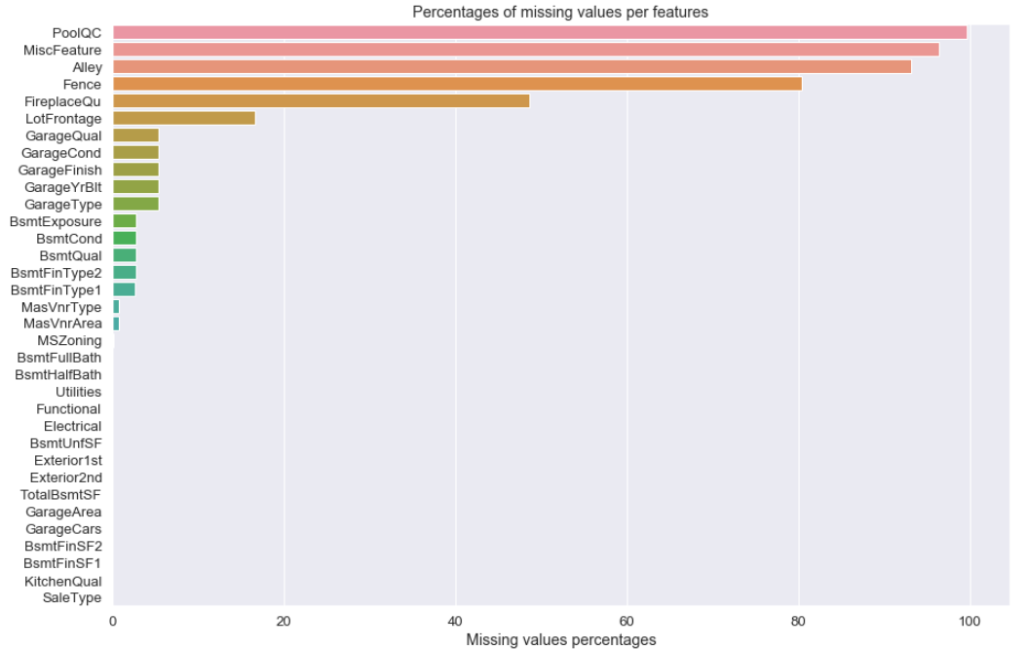
Missing values
High

Slide 8
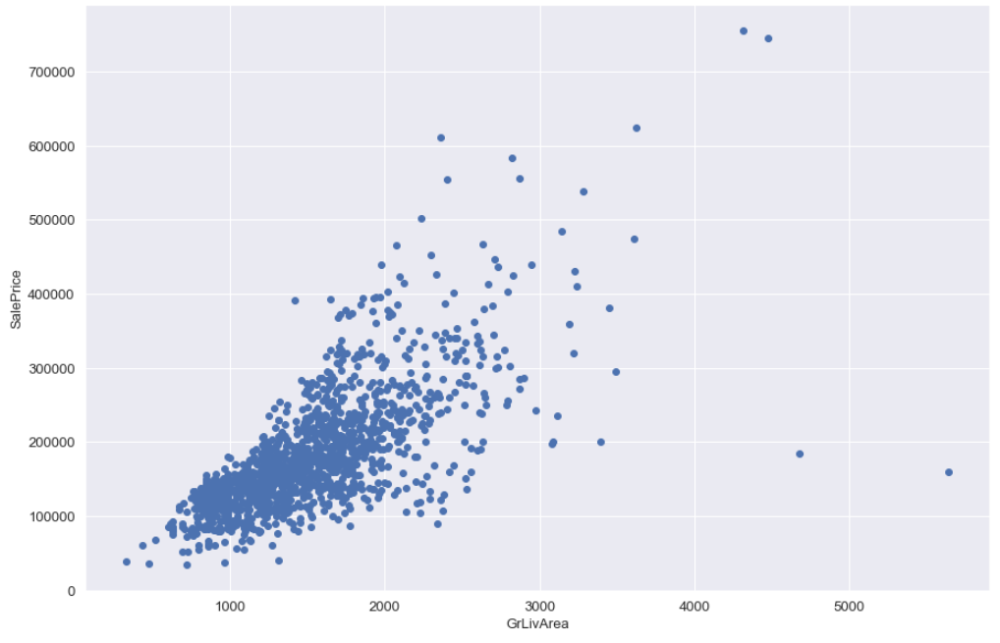
Outliers detection
Outliers

Slide 9

Data cleaning
Handling missing values & outliers treatments

Slide 10
Data Cleaning
Outlier treatment
Missing replacement
3 different type of replacement :
Categorical value missing and corresponding to the absence of an object (example : missing in PoolQC = no pool). -> NA replaced by “No”
Categorical missing designing the quality of an object. -> Replaced by average quality.
Continuous variable with missing. -> Replacing the NA by applying a linear regression model on an highly correlated variable.
Plotting Sale Price by Living Area (GrLiveArea)
4 outliers identified
Removed by dropping values with a GrLiveArea above 4 000 sq foot.

Slide 11

Features engineering
Variables creation and transformation

Slide 12





Variables creation
Total Square Floor
Avg Score Cat Ord
Total Bathrooms
Total Porch
Total square feet
Sum of square floor of based area + 1st floor + 2nd floor
Average score of all categorical ordinal variables.
Total number of bathrooms per house.
Sum of porch squared feet
Sum of square floor of based area + above grade (ground) living area square feet

Slide 13





Variables Transformation
Target transformation
High Skewed variables
Log transform SalePrice to get it normally distributed
Log transform numerical predictors with more 0.5 skew score or less – 0.5 skew score
Cooking the ingredients for the model
False numerical
Categorical ordinal into numerical
Transform numerical that are in fact categorical into string
Replace with number the score gave with text

Slide 14

Modelling
Algorithms selections, best models and bagging

Slide 15

Models Tested
1
Random Forest
6
Lasso Lars
XGBoost
2
Lasso
5
7
Ridge Regression
3
KNN
8
4
LGBM
Elastic Net

Slide 16
Best Models
Random Forest
Our classic Jack-Of-All-Trade. Training fairly quickly with a correct RMSE, but the more we tune it, the more it overfits.
85%
XGboost
Random Forest but with a gradient boosting framework. Usually better performing than the Random Forest.
60%
55%
Lasso
40%
Strong and independent model that selects its own variable and regularize them.
Elastic Net
A linear regression on steroids, with a robust scaler to punish any overfitting.

Slide 17

The Bagging : One model to rule them all
LGBM
A combination of a gradient boosting and The Flash.
Lasso
Strong and independent model that selects its own variable and regularize them.
Elastic
A linear regression on steroids, with a robust scaler to punish any overfitting.
XGBoost
Random Forest but with a gradient boosting framework. Usually better performing than the Random Forest.

Slide 18

Results
Kaggle score and models score

Slide 19
Models Score
Models with parameters
Log RMSE 10K cross validation
1
XGBoost – Grid Search
0.11346141325099346
2
LGBM – Grid Search
0.11294939776325266
3
Lasso – Robust Scaler
0.1124320235610338
4
Elastic Net – Robust Scaler
0.11277397381395365
5
Bagging XGB / LGBM / Elastic / Lasso
0.10918157271721247

Slide 20


Rank: Top 13% – 554 / 4524
Score: 0.11788 – Log RMSE
Kaggle Score
“L’important c’est de participer – Pierre de Coubertin”

Slide 21

Thank you
From the Rocket League team!

